Slide 1
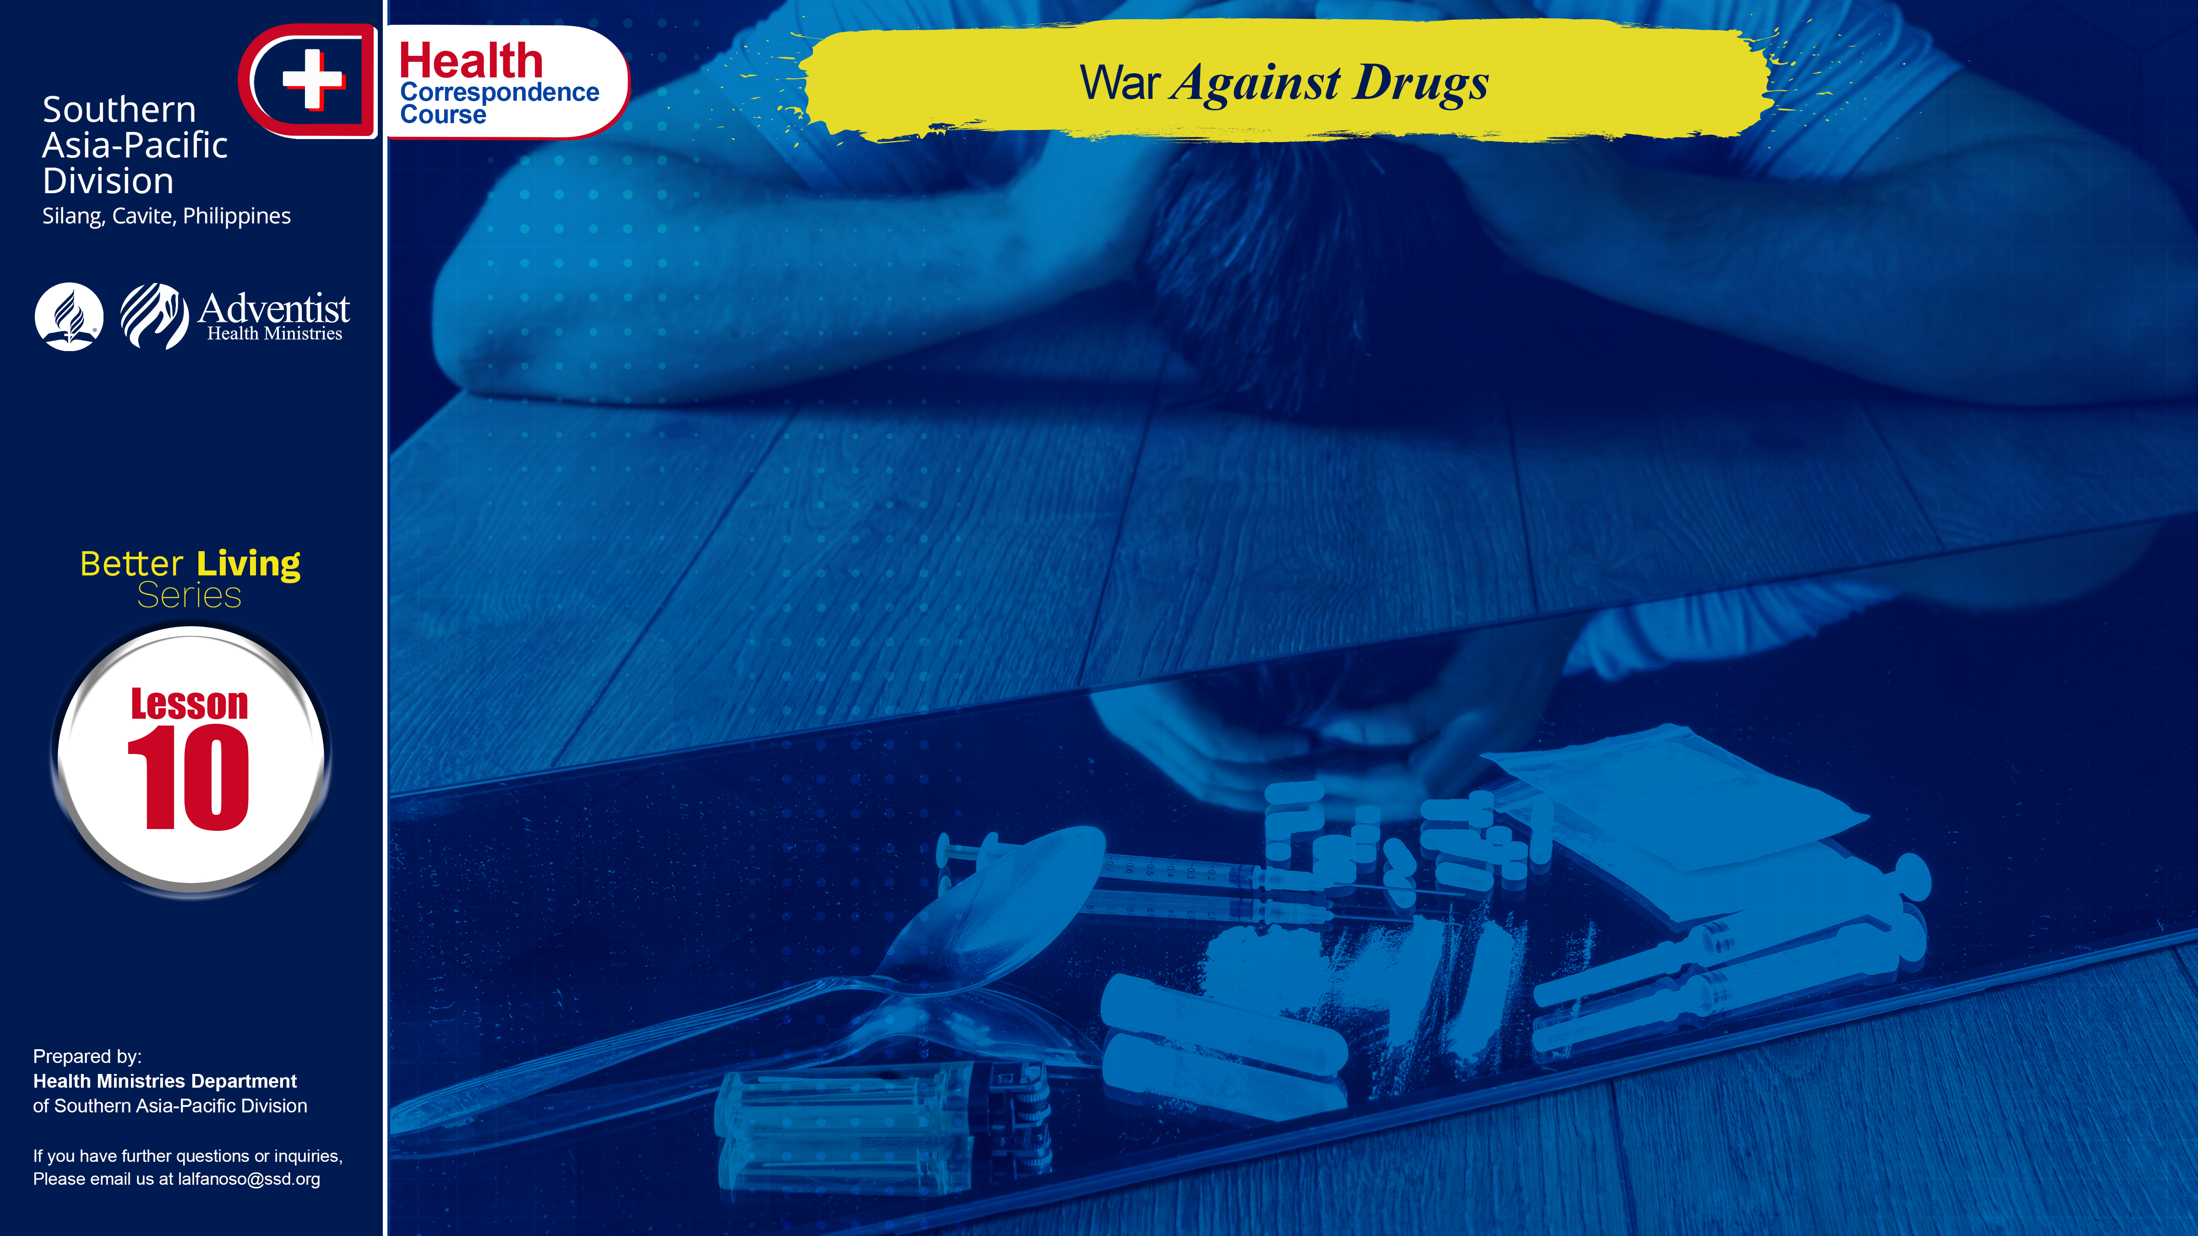

Slide 2
Each year, hundreds of people just like you, harm their bodies by using drugs. Many don’t even realize the degree to which they are hurting themselves. Drugs can kill you. In fact, injected amounts of any kind of drugs may transmit the virus that causes AIDS. Do yourself a favor, don’t start – don’t even try them.
Drug abuse can come in many forms. It can mean using drugs in forms and styles that are illegal; or using drugs to the point where the user loses control of his behavior.

Slide 3
WHO IS A DRUG ABUSER
Anyone can be a drug abuser. Drug abuse is no respecter of age, sex or social status. Here are some signs or symptoms of drug abuse: depression or mood swings, violent outbursts of anger, hyperactivity, drowsiness or forgetfulness; bloodshot eyes, runny nose or coughing, use of eyedrops or incense; frequent bouts with colds or flu; has blackouts, memory lapses, tremors, hallucinations or delusions; change in speaking patterns, time distortion, decline in productivity at school or work;
. . .

Slide 4
WHO IS A DRUG ABUSER
. . .
new interests and friends — especially over old friends; gives up usual sports or hobbies; false sounding excuses; frequent absences or lateness; doesn’t tell you where he/she is going or with whom; careless or foolish risk taking; odd small containers in pockets or purse; money problems, often borrows or even steals money; alcohol, drugs, or possessions disappearing from the house; drug paraphernalia, such as pipes, papers and razor blades.

Slide 5
CONTRIBUTORY FACTORS TO DRUG ABUSE
The abuse starts from the innocence and curiosity of people in the improper use of drugs, aggravated by multi-faceted problems. Any or all of these factors influence the young people to abuse drugs. In the family, what triggers the child to engage in drug abuse is to escape from strict and domineering parents and parents who have no time to communicate to their children.

Slide 6
EFFECTS OF DRUG ABUSE
In the case of marijuana smoking, it irritates the throat and lungs and can lead to lung disorders. Cocaine can kill suddenly. Medical complications include: chronic nasal congestion, frequent nosebleeds, ulcerations of the nose, lung damage from freebase smoking, rapid irregular heartbeat, cerebral hemorrhage (bleeding in the brain), seizures, stroke and respiratory failure.
. . .

Slide 7
EFFECTS OF DRUG ABUSE
. . .
Heroin can cause heart rhythm problems, skin lesions, tetanus, liver disease, seizures, chronic brain damage coma and death. Amphetamines can cause elevated blood pressure and in some cases, physical collapse, injected amounts can result in heart failure or stroke. To sum up there’s no good thing that drugs can do, you just let your body suffer if you engage in such activities.

Slide 8
PREVENTION
The old adage, “An ounce of prevention is worth a pound of cure”, is an obvious truth in the fight against drug abuse. Drug abuse prevention, therefore, must be a world-wide activity aimed at reaching every nation, society, community, family, school and business. Prevention includes both halting drug use and convincing those who use drugs to quit. Before condemning any drug habit, make sure you are setting the very best example yourself.
. . .

Slide 9
PREVENTION
. . .
Involve young people or even the adults in worthwhile community activity; engage them in sports or livelihood programs just not to make them idle that may lead them to try bad habits.
Make no mistake about it – there is no such thing as a safe way to use drugs. Even legal drugs have the potential to harm if they’re misused.

Slide 10
GOD’S WAY TO ULTIMATE HEALTH
Fill in the blanks with the right answer.
___________ _______________ irritates the lungs and may lead to certain lung problems
________________ can suddenly kill
Give two contributory factors of drug abuse that was trigger by the family.
Drugs can kill you.
TRUE FALSE
Injected amount of amphetamine can lead to stroke.
TRUE FALSE
. . .

Slide 11
GOD’S WAY TO ULTIMATE HEALTH
Fill in the blanks with the right answer.
. . .
Drug abuse is no respecter of ________, __________, __________.
Sight three signs of a person abusing drugs.
a. ________________________________
b. ________________________________
c. ________________________________

Slide 12
NAME: ______________________________________
ADDRESS: ______________________________________
AGE: ______________________________________

