Slide 1
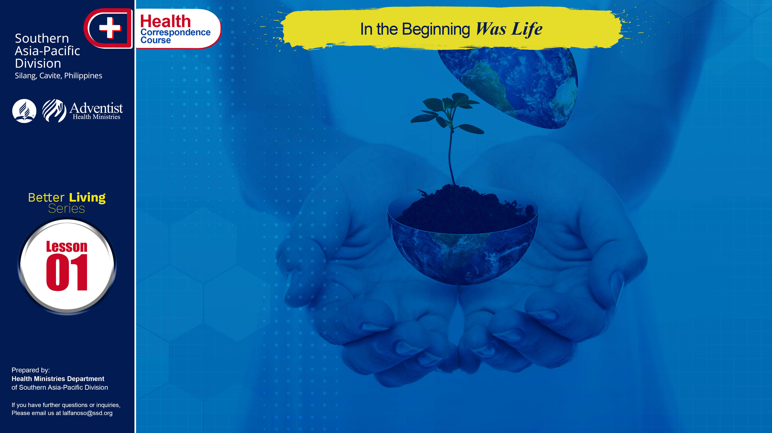

Slide 2
Just stand beside some stream or pond or even in a garden on a warm sunny day and look at all forms of life around you. The whole world is alive and beautiful. In the air, birds are flying to and from. On the ground, you may see ants, beetles, spiders, lizards, and many other forms of life. Even the soil beneath your feet is filled with living things.
Finally, take a good look at yourself. Believe it or not, you are the most important of all. No other form of life has a body as marvelous as yours. No other is so complex or so perfectly balanced. No other creature has a mind like yours. Every part of your own wonderful body is alive! Each organ is doing its part to keep you in perfect health.

Slide 3
HOW LIFE BEGAN
How did all these great systems of life come into being? Let us step back in thought to the very beginning of time, to that wonderful day when our world was young and fresh from the hand of the Creator.
What thrilling moments when at the word of the Creator all the many different forms of life suddenly came into being. From that moment on, the great cycle of life was set in motion. The young planet was ready and able to sustain life.
. . .

Slide 4
HOW LIFE BEGAN
. . .
Life is such a mysterious thing. It is far beyond our power to describe it, or even to understand what it really means. From where then did it come? The answer is plain; And the greatest scientist can only bow his head and repeat the words of Moses, “In the beginning God” ..... (Gen. 1:1) God’s great miracle — the formation of life and remember you are GOD’S MASTERPIECE!

Slide 5
HOW LIFE REPRODUCES
How do living plants and animals reproduce themselves? All forms of life, except the tiniest single-celled animals, reproduce themselves by some kind of seed. In plants this seed is a simple cellular structure. If the soil is good, and if there is sufficient warmth and moisture, the seed will germinate and grow. From that one single cell, innumerable other cells will develop into an organized structure, and soon a new plant will come unto being.
. . .

Slide 6
HOW LIFE REPRODUCES
. . .
The same is true of insects and most of the lower forms of life. The mother usually prepares a suitable rest wherein she lays her eggs. If conditions are favorable a new cycle of life will commence, and this in turn will give rise to still other generations. Such are the unchanging laws of nature. Each new cycle follows in exactly the same pattern as the one which preceded it.

Slide 7
HOW BABIES BEGIN
In the human, the fertilized ovum, or egg cell, remains within the body of the mother for about forty weeks or nine months. There it continues to grow and develop until eventually it becomes a baby weighing seven or eight pounds, million times the size of that first single cell – and all that happens in just nine months! Never again will that young human grow so rapidly.
. . .

Slide 8
HOW BABIES BEGIN
. . .
During this long period of growth within the mother, all the various parts of the body are formed. At first they are very tiny, but each part is already capable of some function. Everything is perfect, so that at birth we are presented with a beautiful baby, possessing the ability to live and grow to a normal adult.
. . .

Slide 9
HOW BABIES BEGIN
. . .
How did it all happen? As soon as the ovum is fertilized, it begins to grow and enlarge rapidly. From each parent it has already drawn the genes which determine its sex, height, coloring, and to some extent even its life span. Some characteristics are dominant; others are in the background and said to be recessive or hidden. But they are all there from the moment of conception within the first rapidly growing cell. Such is the miracle of life.

Slide 10
ORGANS DEVELOP
Some of these cells serve as a covering for the body. They become skin, hair, nails, and mucous membranes. Others are found into muscles and bones. Still others seem to arrange themselves into groups to form the various internal organs of the body, such as the liver, kidneys, heart and blood vessels.
. . .

Slide 11
ORGANS DEVELOP
. . .
The wonderful process of growth goes on. Nerves grow out to the tissues and organs, long before they are needed. A strong framework of tough tissues is laid down in cartilage which later develops into bones ready for the time when powerful muscles will cover them.
. . .

Slide 12
ORGANS DEVELOP
. . .
The lungs develop first of all as solid glands. Yet they are so arranged that they can expand the moment the baby draws his first breath. The voice box or larynx will be ready when the baby talks and sings.
. . .

Slide 13
ORGANS DEVELOP
. . .
Soon tiny buds appear, apparently useless at first, but later these become arms and legs. Other organs, such as the eyes, ears, nose, and tongue, seemingly unnecessary in that watery darkness in which they are formed, are all prepared waiting for the time when they will be needed in the world of sunlight and sound. Nothing is forgotten. No detail is overlooked. Every feature is perfectly planned. Could anyone really imagine all this “just happened”?

Slide 14
WHO PLANNED ALL THIS?
At the end of the ninth month the miracle is complete. The baby is now ready to be born. What is this mysterious thing that we call “life”? What is the marvelous power by which that tiny fertilized egg begins to divide and develop into more and more cells, until in the end there are billions of them, each fulfilling its own place and destiny? Who planned all this marvelous human system? Only God can do this.

Slide 15
ADVICE FOR MOTHERS TO BE
The mother who is expecting a baby should guard her health well, for upon her depends the health and happiness of the next generation.
She will be wise to avoid all excesses such as tobacco and alcohol and all heavy meats especially pork. Such substances contain poisons which may endanger her own health and also the health of the baby.
. . .

Slide 16
ADVICE FOR MOTHERS TO BE
. . .
The young mother’s diet should be simple and nourishing. She should use milk, fruits, and vegetables freely. She should use unpolished rice, legumes, and nuts. Also, it is important for her to be under the care of a well-trained doctor.

Slide 17
GOD’S MASTERPIECE
Life is a fascinating study in all its various forms. But never does it mean quite so much as when that one tiny cell grows into a beautiful, cultured woman, or into a strong, noble man. To man has been granted that tiny spark of life. It is his to guard and to use but not to destroy. It is his responsibility to avoid everything that would corrupt the mind or weaken the body, for what destroys these, destroys the masterpiece creation! Remember 1 Corinthians 10:31, - Whatsoever ye eat, or drink, or do, do all to the GLORY of GOD!

Slide 18
GOD’S WAY TO ULTIMATE HEALTH
True or False
God’s greatest miracle—formation of life
Perfection is seen in every part of the human body.
Most sickness results from poor habits of living.
Expectant mothers may eat anything they wish
During the long period of growth within the mother all the various part of the body are formed.

Slide 19
Fill in the blanks:
The whole creation was created by ____________.
Babies are born from a single fertilized cell, called the _____________.
Expectant mothers should avoid certain things such as __________, ___________, ________.
Expectant mothers should freely use such things as _______, ________, _________, _______.
In the human, the fertilized ovum or egg cell, remains within the body of the mother for about ___________ weeks.

Slide 20
Has this study impressed you with the sacredness
of your body and the importance of keeping it in health?
Do you have some health habits you would like
to change? If so, what?
NAME: __________________________________
ADDRESS: __________________________________
AGE: __________________________________

