Slide 1
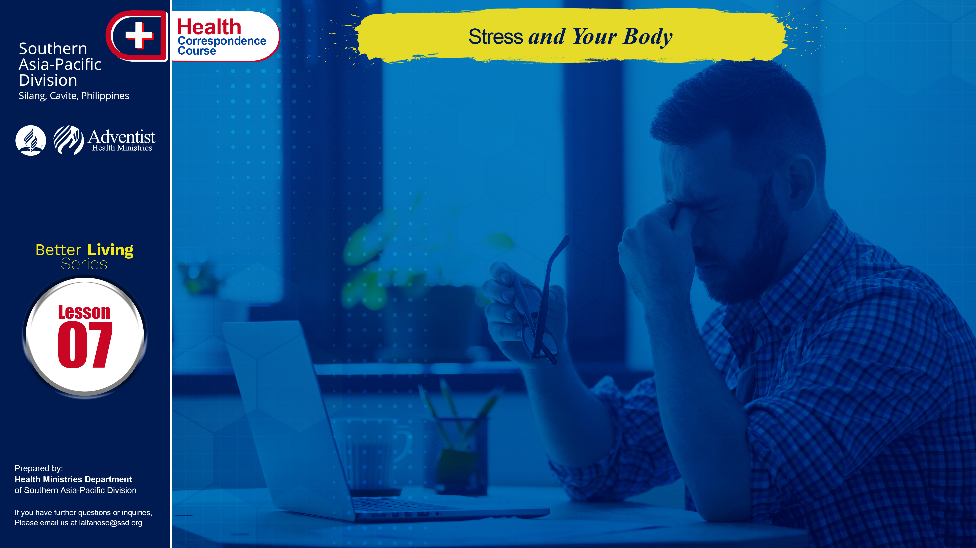

Slide 2
Modern society is fast-paced and competitive. Its pressures and problems within the rapidly changing environment of a complex technologic age affect air, water, and food. Modern life’s stresses, either physical or psychological, often contribute to disease and malnutrition.

Slide 3
The “middle years”, referring to the early twenties up to the sixties, is the largest portion of a person’s life span. This period is also referred to as the “employment age” — and is usually the most productive. It is the time for job, achievement and recognition, child rearing and the establishment of lifestyle, values, and attitudes that will be transmitted to one’s children. However, it is also the most stressful period in an individual’s life. Most people are in relatively good health at this age.
The middle years are an important time for education and medical care to preserve health and prevent or delay the onset of chronic disease.

Slide 4
WHAT IS STRESS?
For an individual, stress can be defined as being under a constant state of tension as a result of daily pressures. Stress is a fact of life. The common life stressors are two-fold in nature:
(a) physical or physiologic stress and
(b) psychologic or socioeconomic stress.
The first form of stress may come from injury, disability, disease, or physical abuse. The second form may come from emotional pressures, verbal abuse, or lack of financial resources.

Slide 5
WHAT IS STRESS?
Stress can be avoided but it can be positive or negative. Positive stress can encourage a person to strive and achieve goals. Harmful stress is called distress and can cause anxiety, nutrient deficiencies, and emotional or physical disease.
Undoubtedly, emotional tension from multiple causes is the most common agent of human stress. It can contribute to serious conditions, such as cardiovascular and gastrointestinal problems, diabetes and cancer, especially if the body is conditioned by malnutrition, faulty diet, or poor housing and homelessness.

Slide 6
WHAT IS STRESS?
Common signs of stress:
Recurrent headaches, dizziness, rashes, colds and infections; panic attacks or anxiety, palpitations, sexual problems, indigestion, aches and pains in the neck, shoulder or back; loss of appetite, compulsive eating, irritability, fatigue, tearfulness, sleep problems, lack of concentration, to name a few.

Slide 7
NUTRITION AND STRESS
Stress and nutrition are related. First, a nutrient deficiency is a stress in itself. Second, how well stress is handled is related to how well the body is nourished. Stress and its widespread effects on the body chemistry and functions can interfere with digestion and reduce nutrient absorption and retention. Even a good diet can produce a deficiency when stress is present. Third, a tension-filled day increases loss of several nutrients stored in the body through the urine, and blood levels of many vitamins and minerals are lowered during times of stress.

Slide 8
REDUCING STRESS AND HEALTH RISKS
The preventive approach to developing positive health means making changes whenever necessary to build positive attitudes and habits. This lifestyle approach includes actions in three main areas — exercise, relaxation, and diet — to reduce stress-related risk factors and promote health.

Slide 9
REDUCING STRESS AND HEALTH RISKS
Nutritional balance.
Diet appears to make a difference in the body’s ability to handle stress. People who consume a diet low in refined carbohydrates, sugar, and caffeine and high in whole grain breads and cereals, and other nutritious foods have been shown to have greater ability to cope with stress as compared to individuals who consume their normal diets with sugar or caffeine. In general, we all need to eat a balanced diet that provides sufficient energy to maintain a healthy body weight and supplies all the macro and micronutrients.

Slide 10
REDUCING STRESS AND HEALTH RISKS
Food patterns and pace.
Because of the fast pace of modern living, many persons eat rapidly and irregularly, and suffer both physical and emotional consequences. Persons are better able to deal with stress if they simply slow their eating to savor food, eat smaller “mini meals” more frequently, and avoid the rich, heavy meals that often make up the typical food pattern. Avoid excesses in fat, salt and sugar and in some cases caffeine, mostly in the form of coffee and cola drinks. For some Filipinos, dining out is the number one way to unwind and relax, but still watch out for the right foods to take in. . . .

Slide 11
REDUCING STRESS AND HEALTH RISKS
Food patterns and pace.
. . . There is no “wonder cure” for stress. You have to be aware of wonder-food or supplement claims or magic properties of any specific nutrient or food. What is right for everyone is to have a balanced dietary pattern that is both nutritionally sound and personally satisfying.
Regular exercise, effective stress management, avoidance of alcohol and tobacco, and avoidance of caffeine-containing beverages, such as coffee and cola drinks, are important practices prior to and during times of stress. . . .

Slide 12
REDUCING STRESS AND HEALTH RISKS
Food patterns and pace.
. . . Most of us value the future more than the present, putting off enjoyment today so that tomorrow we will have money or prestige not knowing that a lifetime of effort is required for good nutrition status in later years. How can we enjoy our future if we have wasted or abused our health today? We should never be too busy to take the time to look after ourselves.

Slide 13
GOD’S WAY TO ULTIMATE HEALTH
Fill in the blanks with the words below:
The _______ ______, referring to the early twenties up to __________, is the largest portion of a person’s ___________ ___________. This period is also referred to as the _________ ____________ and is usually the most _____________.
*nutrition *life span *middle years
*employment age *sixties *Stress *productive

Slide 14
GOD’S WAY TO ULTIMATE HEALTH
Check only the right statements.
Physiologic stress and socio-economic stress are the twofold nature of common life stresses.
Common signs of stress are vomiting, sleep problems, headaches and swollen face.
Stress contributes to some diseases such as gastrointestinal problems and diabetes.
Taking of pills can help reduce stress.

Slide 15
NAME: ______________________________________
ADDRESS: ______________________________________
AGE: ______________________________________

