Slide 1
2021 Year-end Report
Pastor Kevin K. Costello
Associate Executive Secretary
Southern Asia-Pacific Division

Slide 2
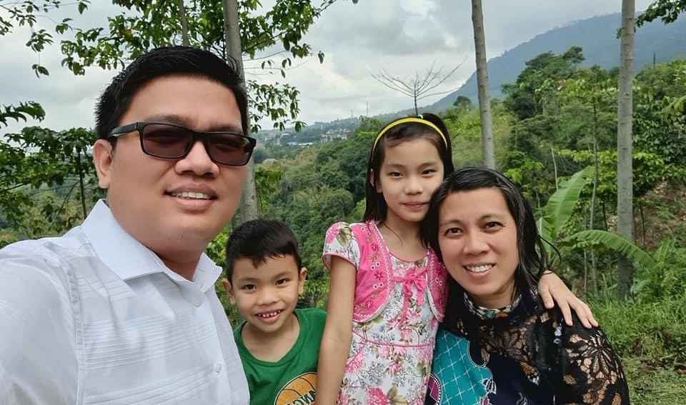
Manurung Family
Notes:
D-ISE: Roni Manurung, TLM Treasurer
Wife: Gina Manurung, TLM Health Ministries Director

Slide 3
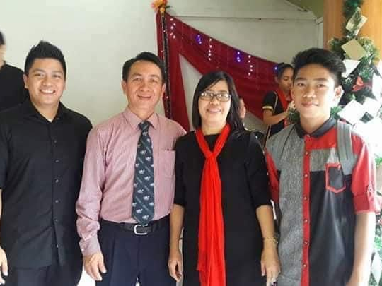
Simbah Family
Notes:
D-ISE: Jibil Simbah, SSD Stewardship Director
Wife: Florida Simbah

Slide 4
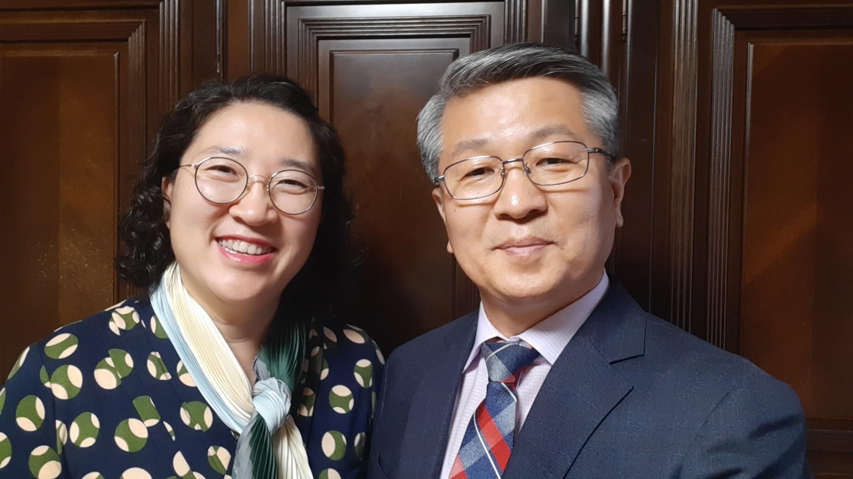
Pastor & Mrs. Won Sang Kim
Notes:
SSD-hosted ISE:
Pastor Won Sang Kim, BAUM President
Wife: Sookyung Kim, BAUM Children’s Ministries Director & Shepherdess International Coordinator

Slide 5
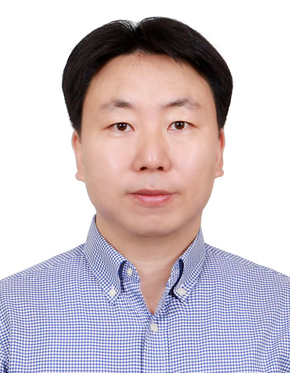
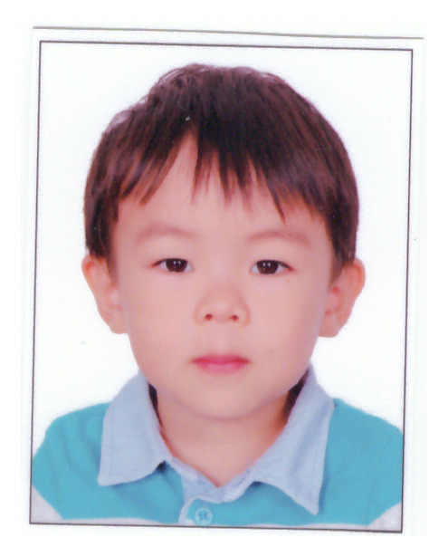
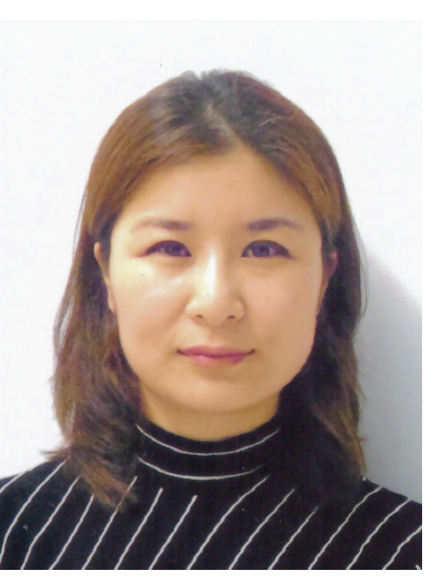
Shin Family
Notes:
SSD-hosted ISE:
Allan Shin, ADRA Bangladesh Country Director
Wife: Kimberly Lee

Slide 6
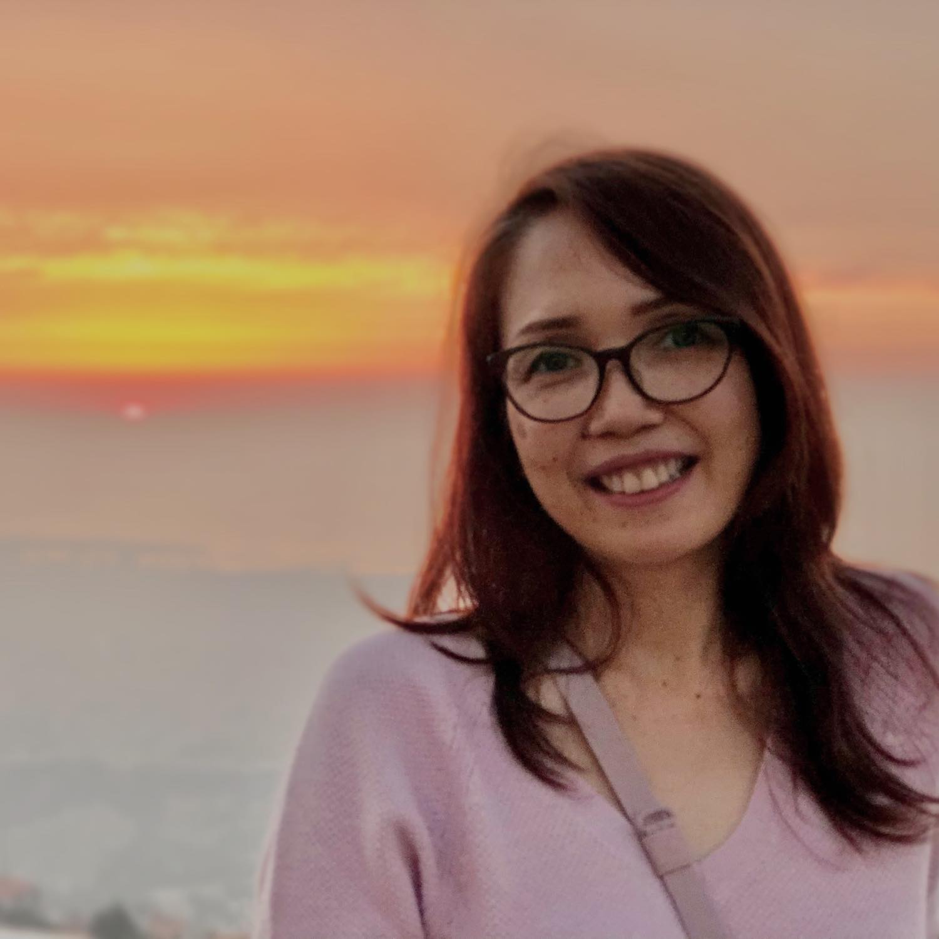
Pema Frasco
Notes:
SSD-based ISE:
Pema Love Frasco, Assistant Treasurer of Middle East and North Africa Union

Slide 7
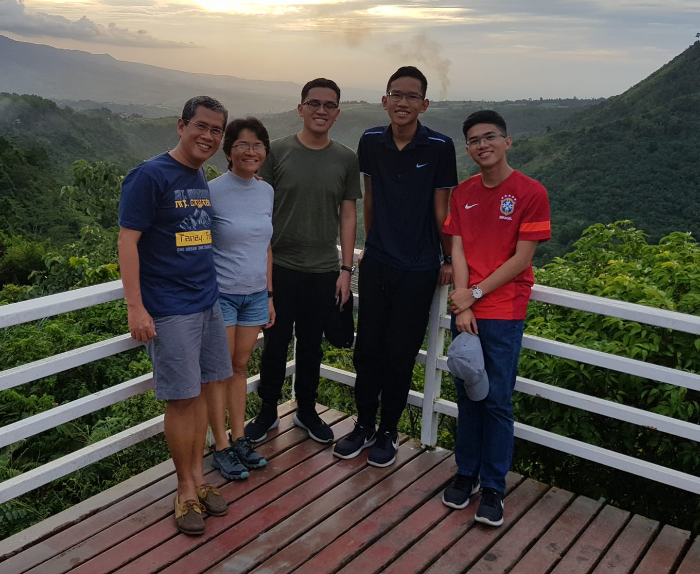
Gayares Family
Notes:
SSD-based ISE:
Dr. Hector Gayares, Administrator of Scheer Memorial Hospital, Nepal
Wife: Jocelyn Gayares, Physician

Slide 8
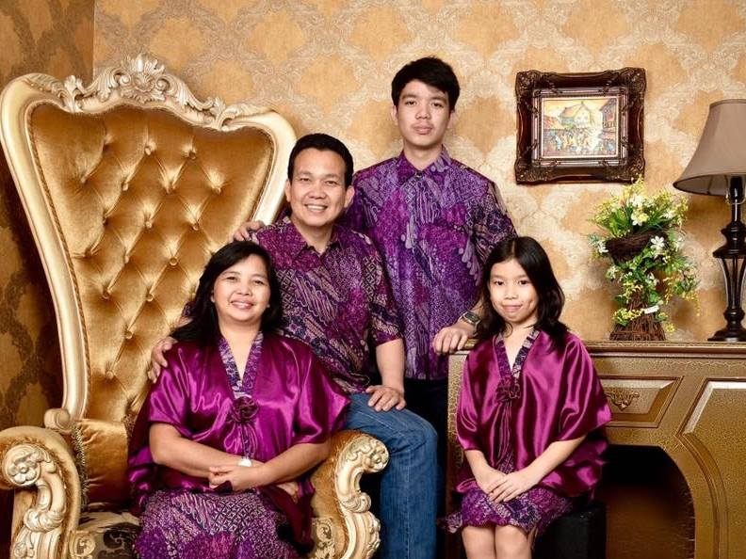
Mamarimbing Family
Notes:
SSD-based ISE:
Ronell Mamarimbing, Lecturer of the Theology Department of Pacific Adventist University, PNG
Wife: Evins Nouke Kumendong

Slide 9

AVS
ONLINE CLASS

Slide 10
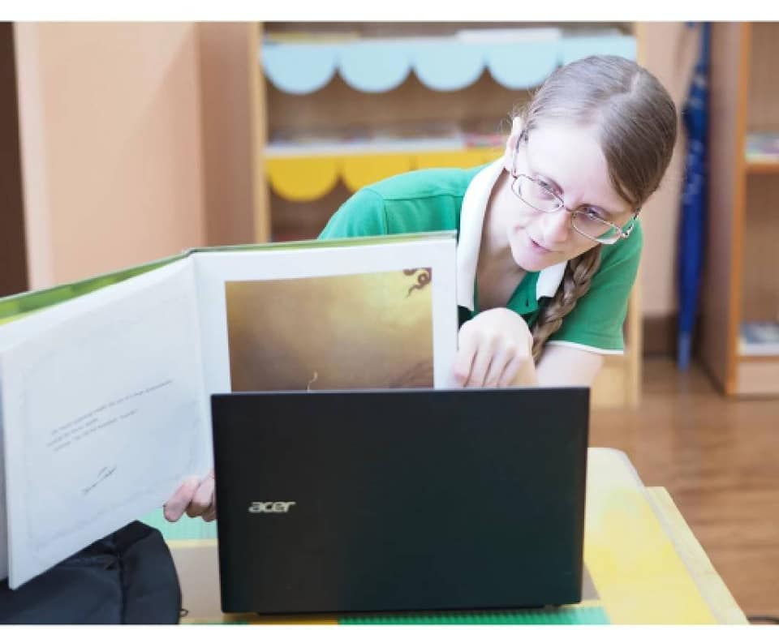
Jessica Fields (NAD)
UAIMS, Ubon Thailand

Slide 11
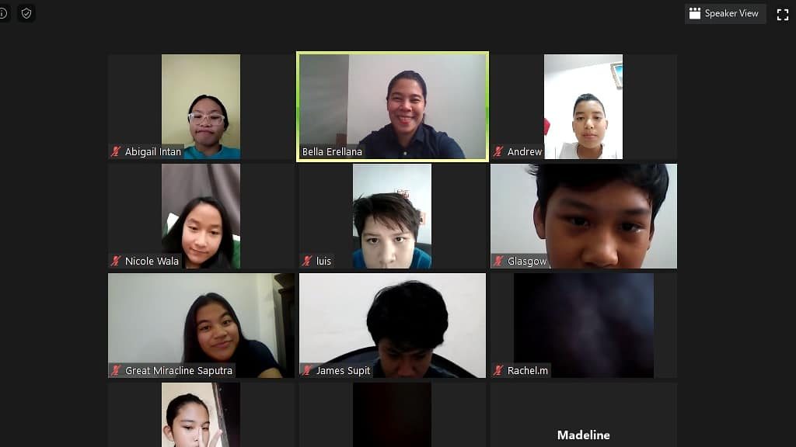
Maribel Erellana (SSD/SPUC)
AECS, Indonesia

Slide 12
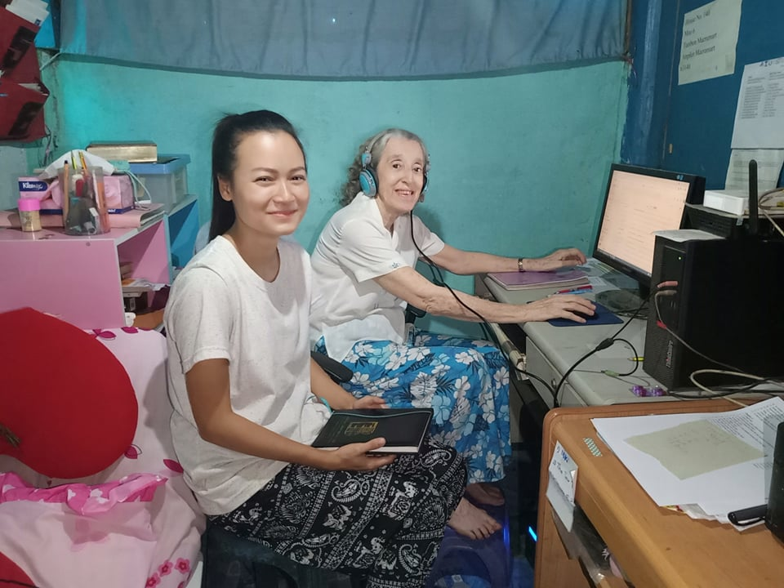
Helen Hall (SPD)
Eden Valley Academy

Slide 13
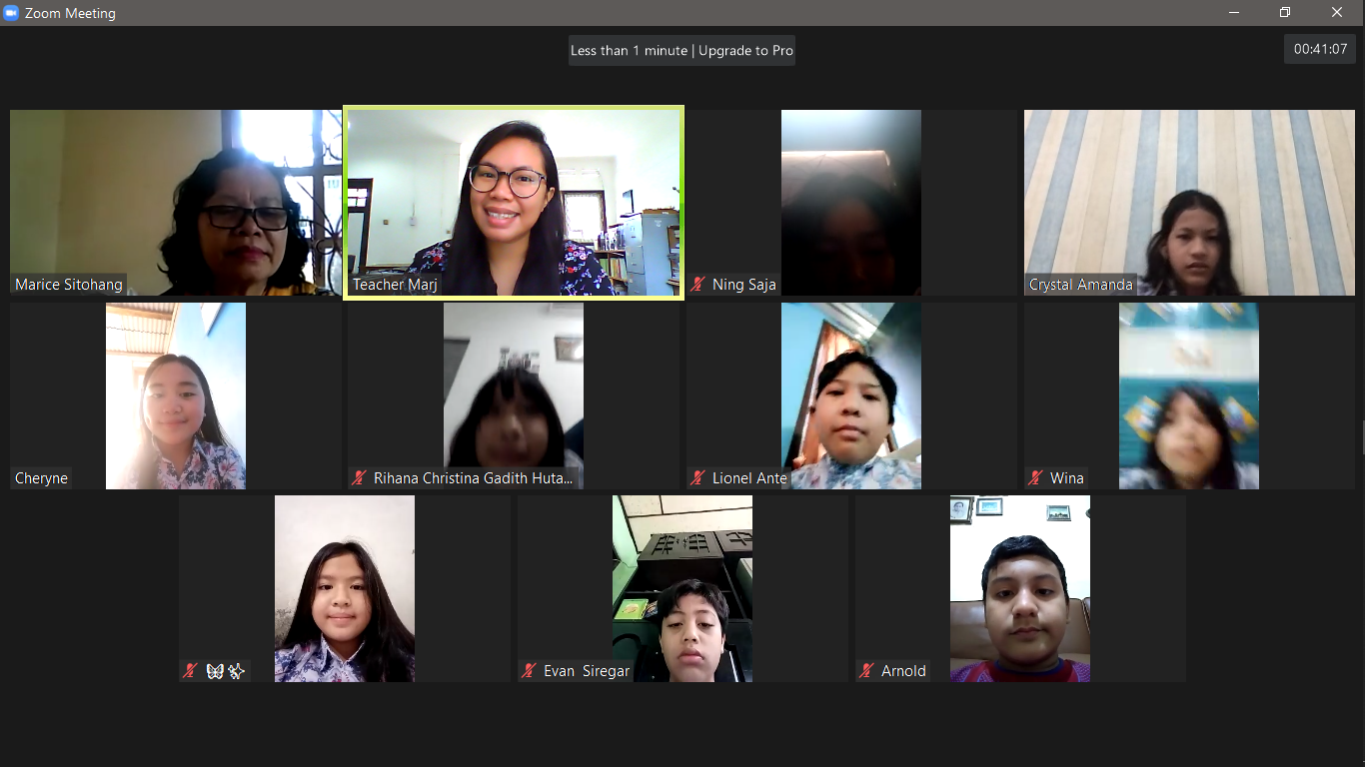
Marjosel Datoy (SSD/SPUC)
AECS, Indonesia

Slide 14

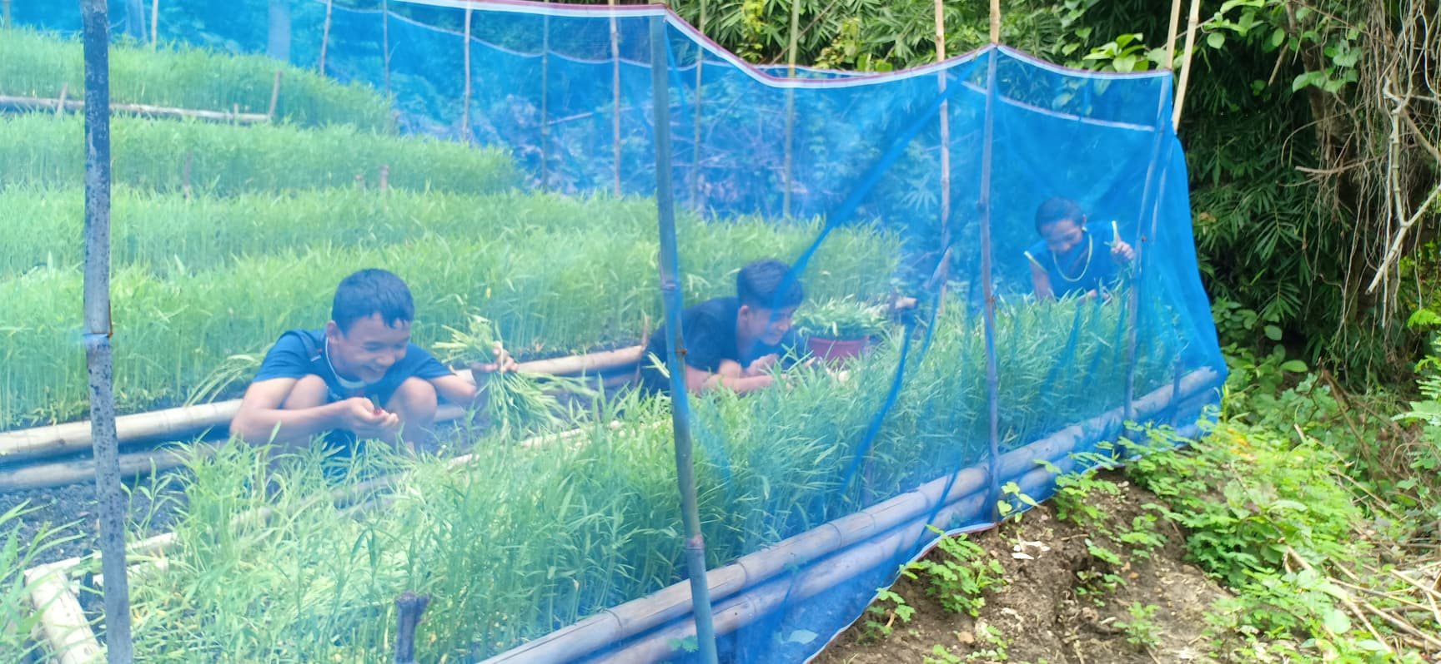
AVS GARDENING

Slide 15
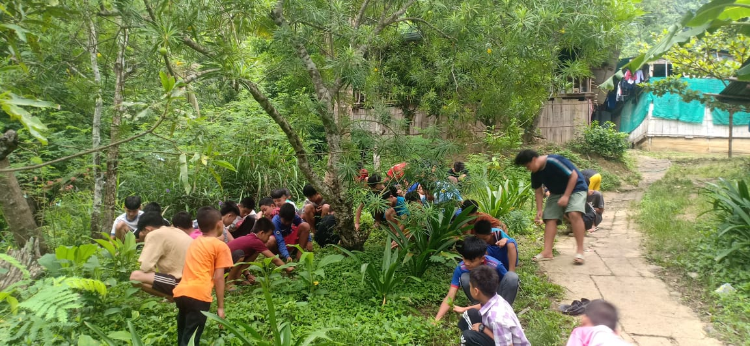
Eden Valley Academy

Slide 16
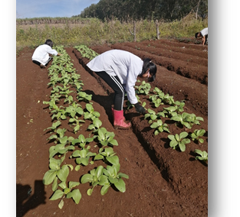
IOU Ministry
Mountain View College

Slide 17

AVS
Face to Face Class

Slide 18
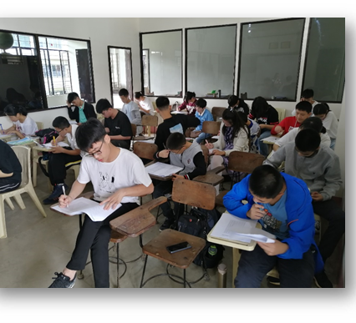
IOU Ministry
Mountain View College

Slide 19
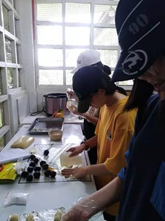
Cooking Class
IOU Ministry

Slide 20
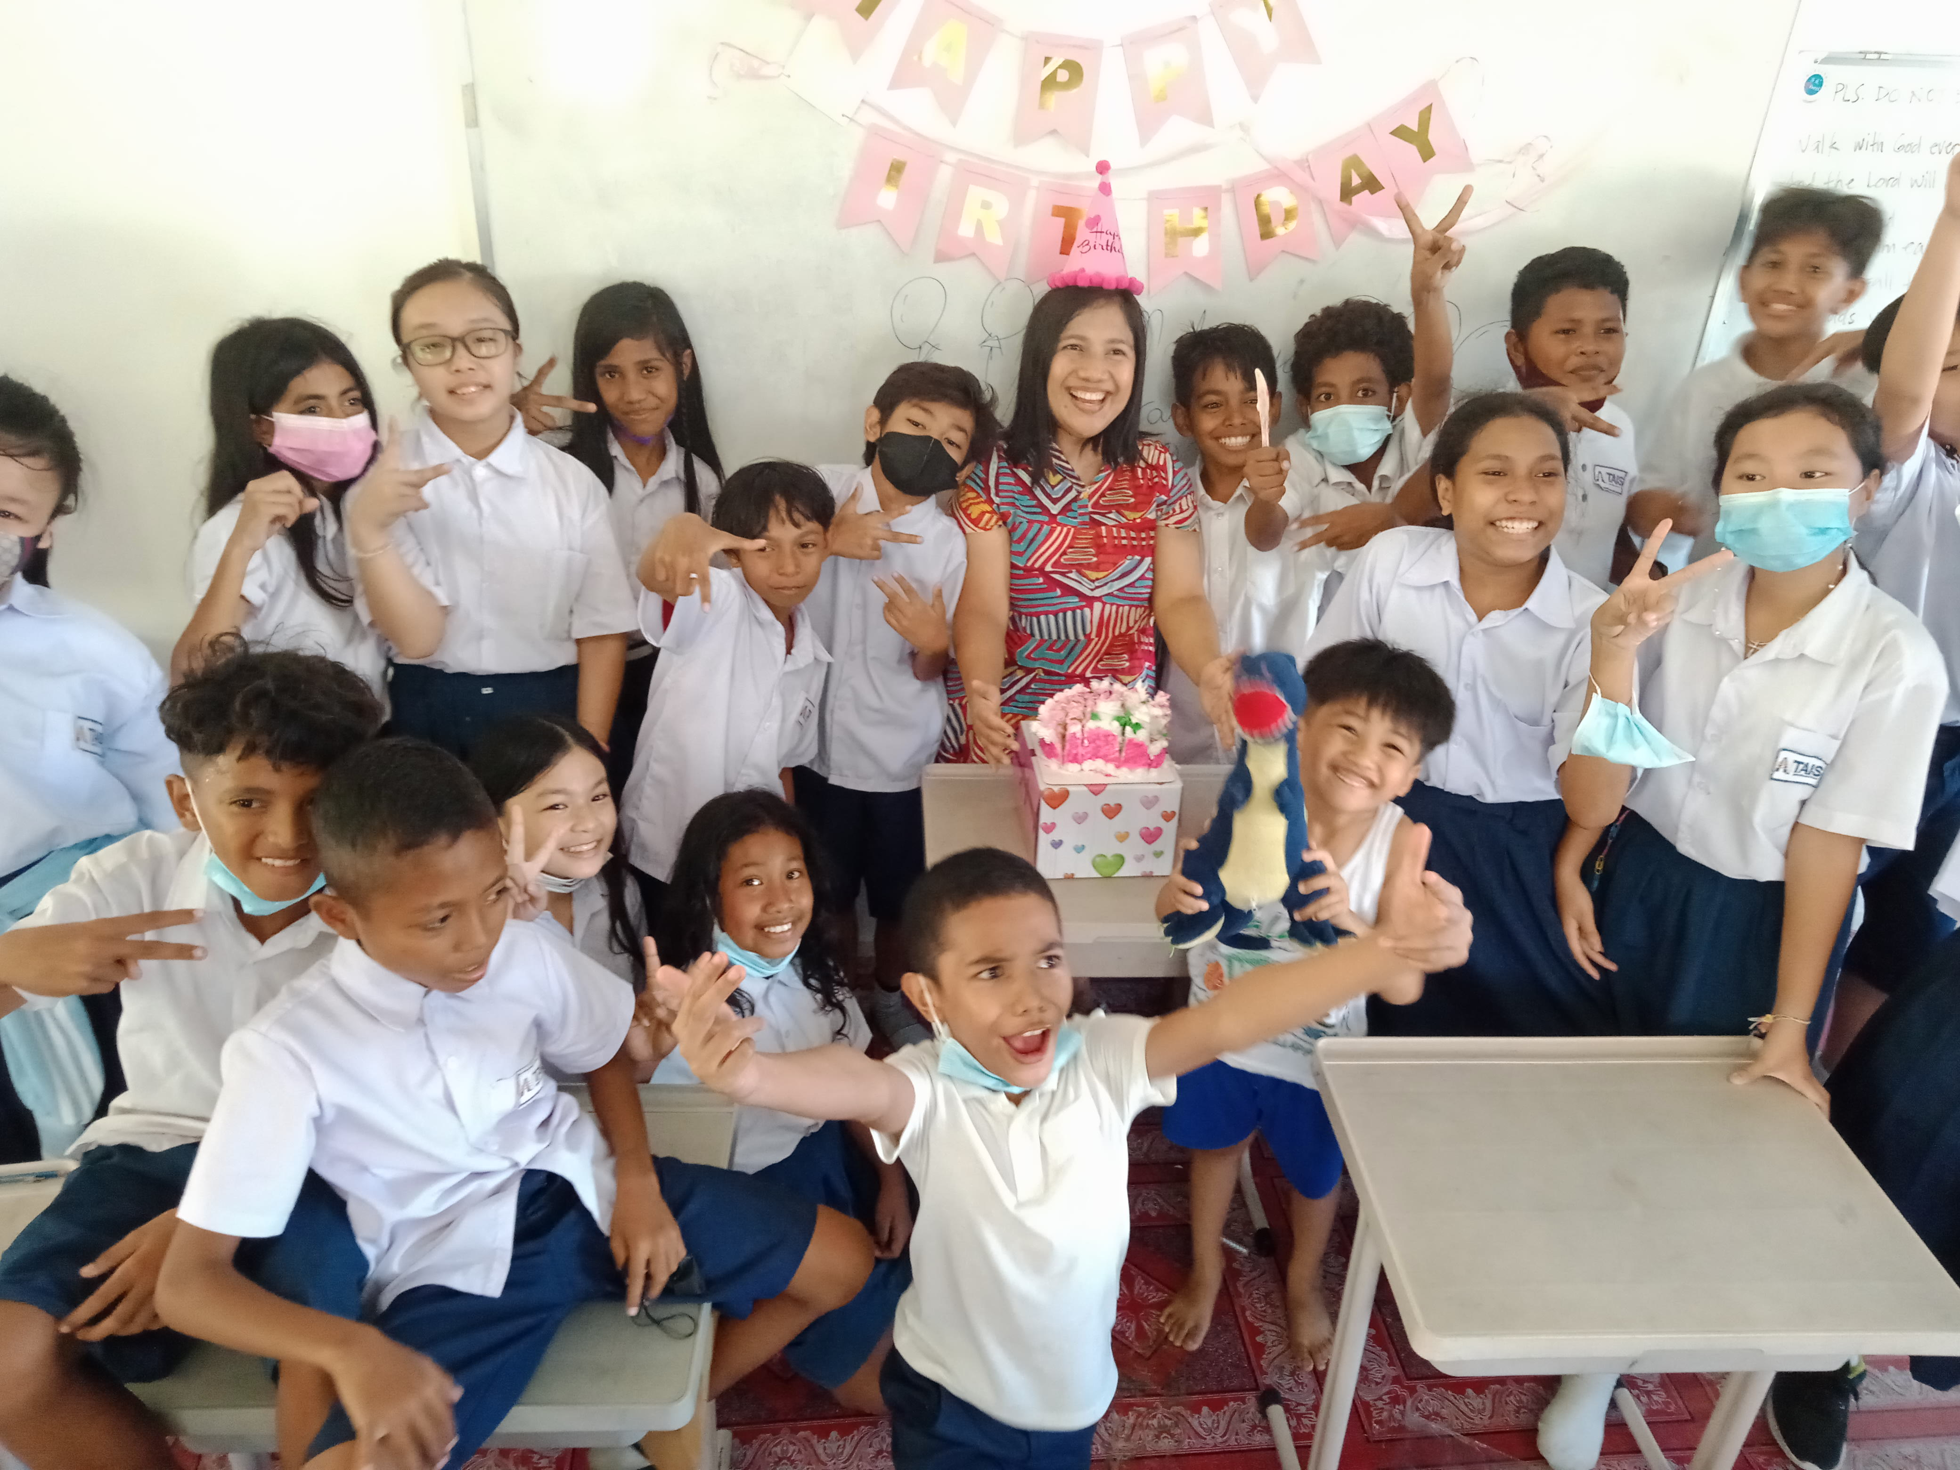
Arjem Agum (SSD/NPUC)
TAIS, Timor Leste

Slide 21
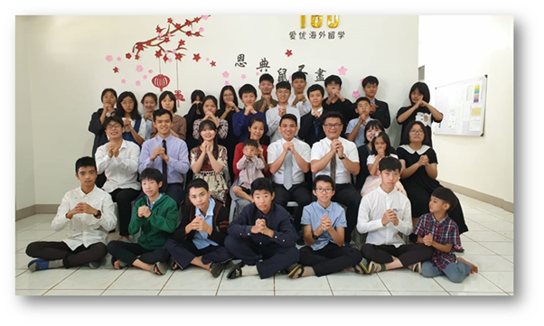
Wong Tat Ying (SSD/SAUM)
Wong Xin Yi (SSD/SAUM)
Shin Te Lu (NSD)
Yue Hua Lin (CHUM)

Slide 22

Kyari Alcantara (SSD, NPUC)
Palau Adventist Academy

Slide 23
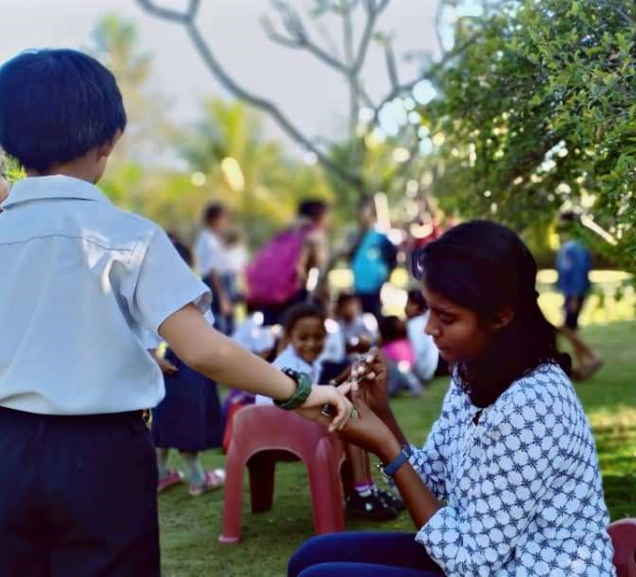
Marian Yaqub (SSD/PKU)
TAIS, Timor Leste

Slide 24
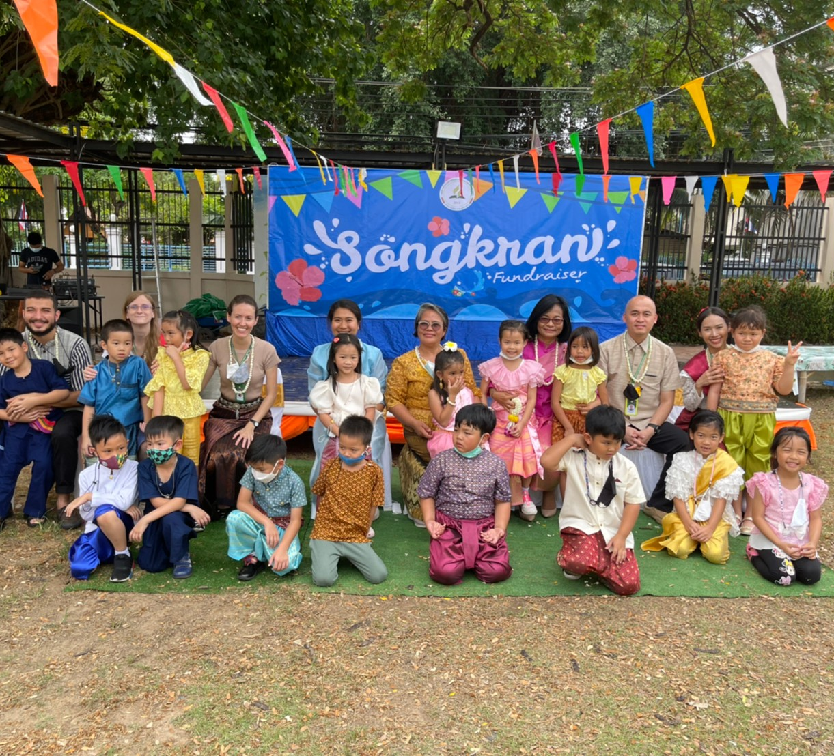
Fundraising
Ira Paghasian (SSD/CPUC)
UAIMS, Ubon, Thailand

Slide 25
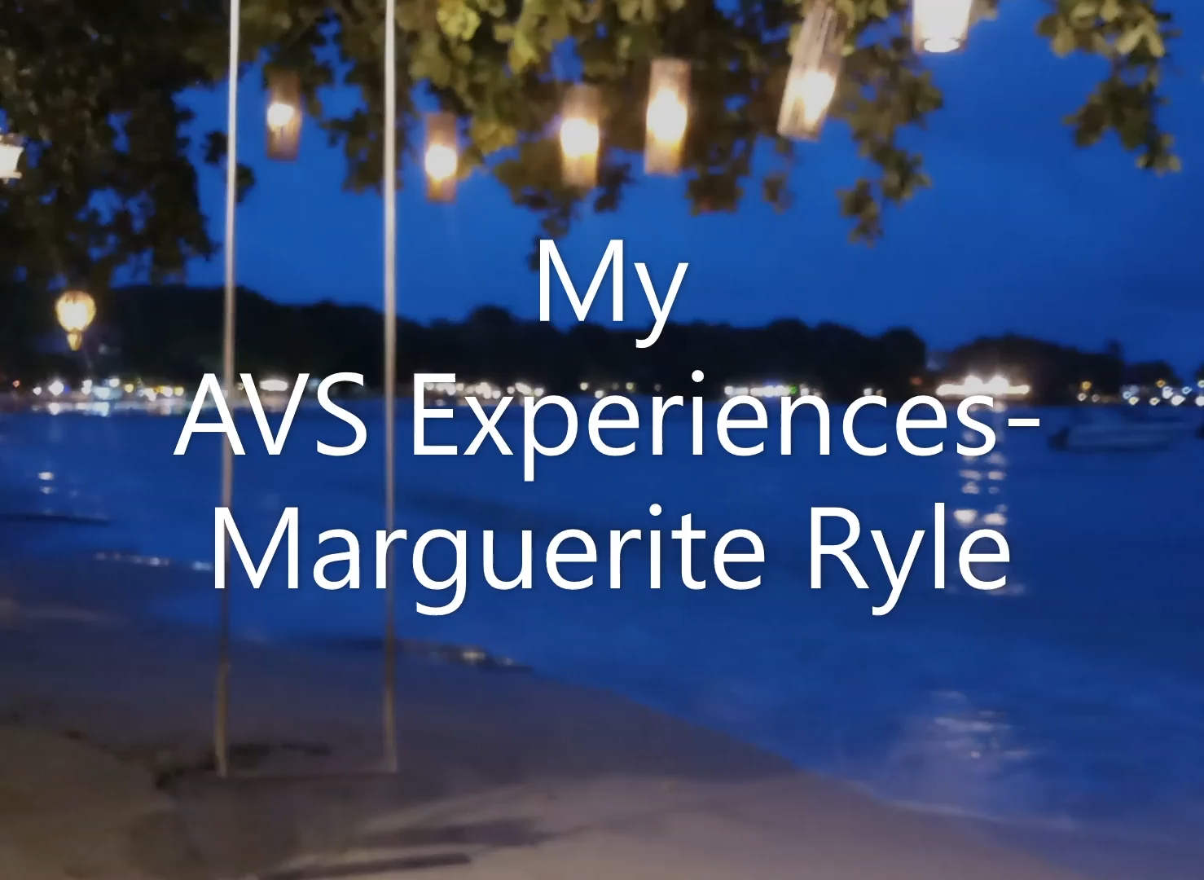
[Re-insert video to play on this slide]
Notes:
Video c/o Edward Rodriguez

Slide 26
ISEs & Employed Spouses to SSD
ISEs to SSD = 62 + 4 pending call

Slide 27
ISEs SSD sends to the World
74 SSD-based missionaries
Notes:
SID receives 29% of SSD-based ISEs.

Slide 28
ISEs from SSD to the World by sending Union
Notes:
SPUC consistently sends most missionaries to the world at 41% followed by NPUC at 23% and CPUC at 15%.

Slide 29
AVS to SSD from other Division
Total: 17 Volunteers
Notes:
62% of volunteers are from NAD.

Slide 30
Volunteers Serving in SSD
Total: 33 volunteers

Slide 31
AVS SSD sends to the World
SSD sends 11 Volunteer Missionaries to the World.

Slide 32
38 Division-ISE

Slide 33
Summary
ISEs to SSD 62 + 4 pending call
ISEs from SSD 74
D-ISEs 38
AVS in SSD fr. other division 17
AVS to other division fr. SSD 11
AVS from SSD to SSD 16
Total Missionaries: 218
Notes:
Total: 217 in-field missionaries (compared to last year’s 222)

Slide 34
Stranded Missionaries
Before: 22 ISEs
18 GC-ISEs
4 D-ISEs
Current: 11 ISEs
8 GC-ISEs
3 D-ISEs
Notes:
Covid-19 Report
Highest stranded missionaries at one point is 22 ISEs (18 GC-ISEs and 4 D-ISEs).
Currently, there are now only 11 ISEs (8 GC-ISEs & 3 D-ISEs) who are stranded in their home countries.
Reasons: Closed borders either way, entry permit or visa issues.

Slide 35
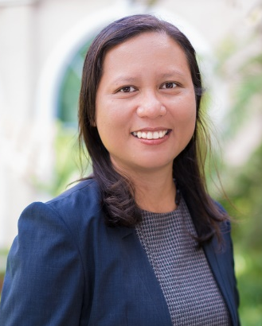
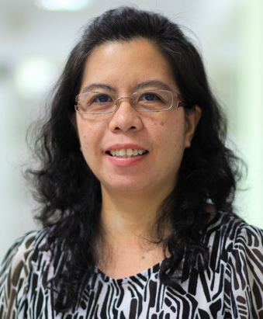
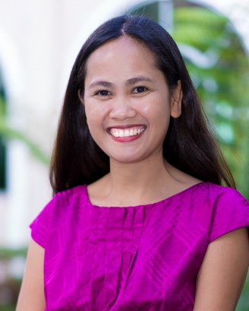
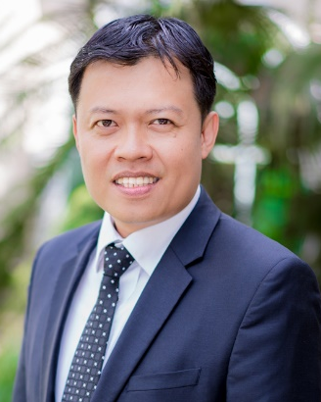
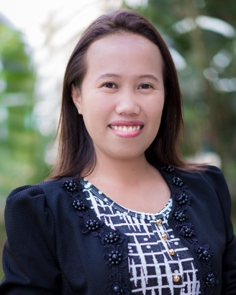
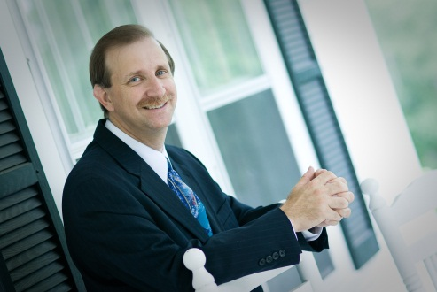
Those Who Serve Those Who Serve
EVE
AVS, Secretariat
NECY
SSD-based ISEs
& D-ISEs, Secretariat
LAILA
SSD-hosted ISEs, Secretariat
ALLAN
ISEs & D-ISEs, Treasury
JENNIFER
ISEs & D-ISEs, Treasury
KEVIN
Missionary Coordinator

